Slide 1

We Rise 4 Wellness
Bringing Wellness and Change to Life – My Internship Journey

Slide 2




About Me
Daniel Benson
Computer Science Major
Senior
Future in Data Science and Neurotechnology

Slide 3
We Rise 4 Wellness
Non-profit
Raise awareness and funds for minority and disenfranchised communities
Wellness, community, and youth programs
Elder programs
Women’s health programs
Educational resources
Public Health awareness
Data Analysis Projects

Slide 4

Data Analyst Intern
Project planning and research
Data wrangling
Data cleaning
Data analysis
Data storytelling/Final report

Slide 5
Clinical Trial Details
The Inner Workings of the Trial

Slide 6
Clinical Trial Details
Time frame:
Data collected from June 01, 2021 – June 07, 2021
Data collected of participants hospitalized within the time period between December 15, 2020 – May 15, 2021 (15 months)
Data collected involved hospital documentation
Groups Involved:
Participants involved three groups of individuals documented due to hospitalization from COVID-19
Unvaccinated: positive lab COVID-19 testing with no record of immunization against COVID-19 or first-dose vaccination after symptom onset.
Partially Vaccinated: positive lab COVID-19 testing and symptom onset after single dose of mRNA (Pfizer, Moderna) vaccine or, <14 days after second dose of mRNA vaccine or <14 days after administration of single dose of viral vector vaccine (Johnson & Johnson)
Fully Vaccinated: positive lab COVID-19 testing and symptom onset >14 days since administration of second dose of mRNA vaccine, or >14 days since administration of viral vector vaccine (Johnson & Johnson)

Slide 7
Clinical Trial Details Cont.
Country of Enrollment
United States – all participants
Primary Outcome
Primarily what is being looked at in the study
Participants presented to Emergency Center or Hospitalized for COVID-19
Secondary Outcome
Secondarily what is being looked at in the study
Data for secondary outcome in partially vaccinated and fully vaccinated individuals is lacking as of this study; not enough numbers to look at
Patients with severe infection; ICU admission, mechanical ventilation, or in-hospital mortality

Slide 8
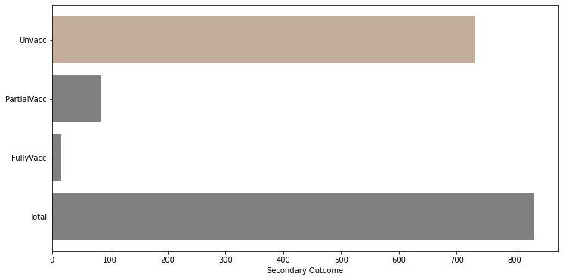
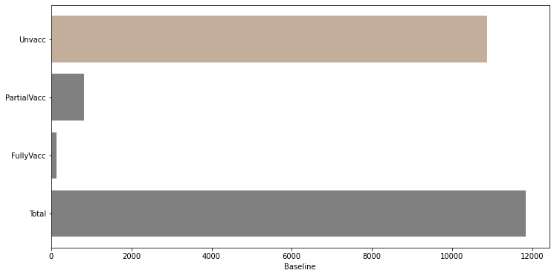
Findings
Number of unvaccinated hospitalizations eclipsed number of partially and fully vaccinated hospitalizations (Top chart).
6.7% of total unvaccinated hospitalizations led to secondary problems, including severe infection, ICU admission, oxygen therapy, in-hospital mortality, etc. (Bottom chart).

Slide 9
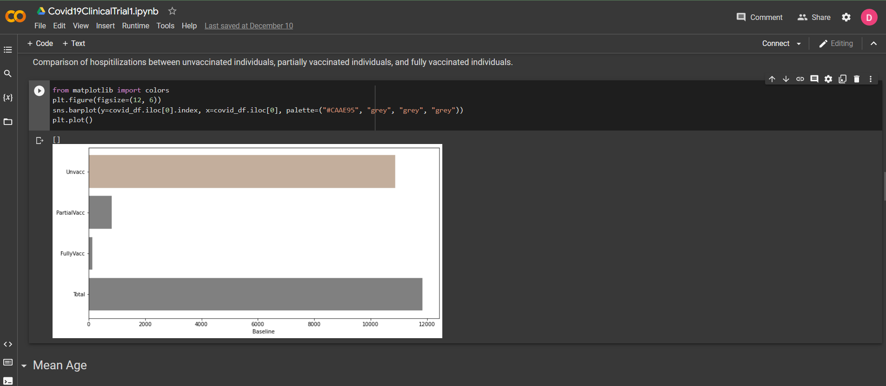
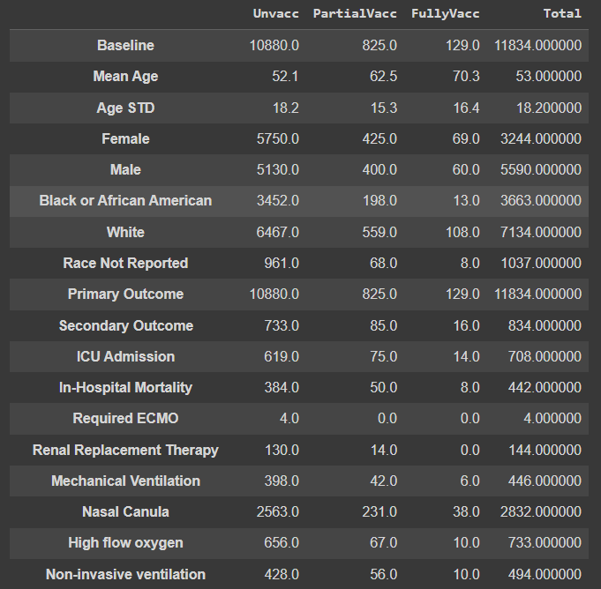
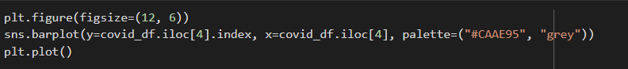
Exploratory Methods
Google colab
Top image
Pandas Dataframe
Middle image
Python programming language
Bottom image

Slide 10

Internship Experience
Changing Goals:
Short-term changes
Continue developing real-world skills and experience
More interaction and collaboration efforts
BUILD PORTFOLIO AND WORK ON PROJECTS!!!

Slide 11

Internship Experience
Personal Growth:
Business communication
Teamwork skills
Research
Storytelling
Presentation skills

Slide 12
Internship Experience
Personal Insights
Real-life data is dirty and difficult to come by
No spoon-feeding in working environments!
Don’t be afraid to ask questions

